Slide 1
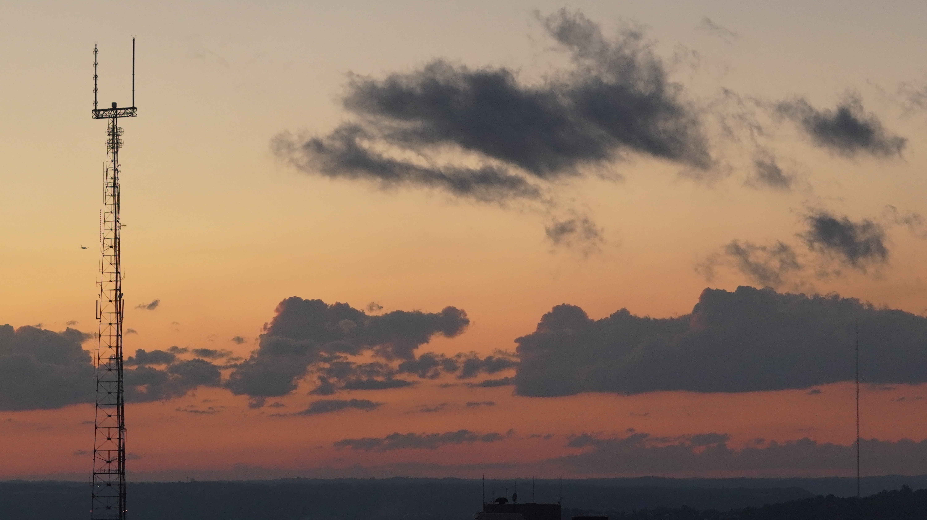
BEST NEIGHBORHOOD IN PITTSBURGH
BY Simon, Janet, and Kyle

Slide 2
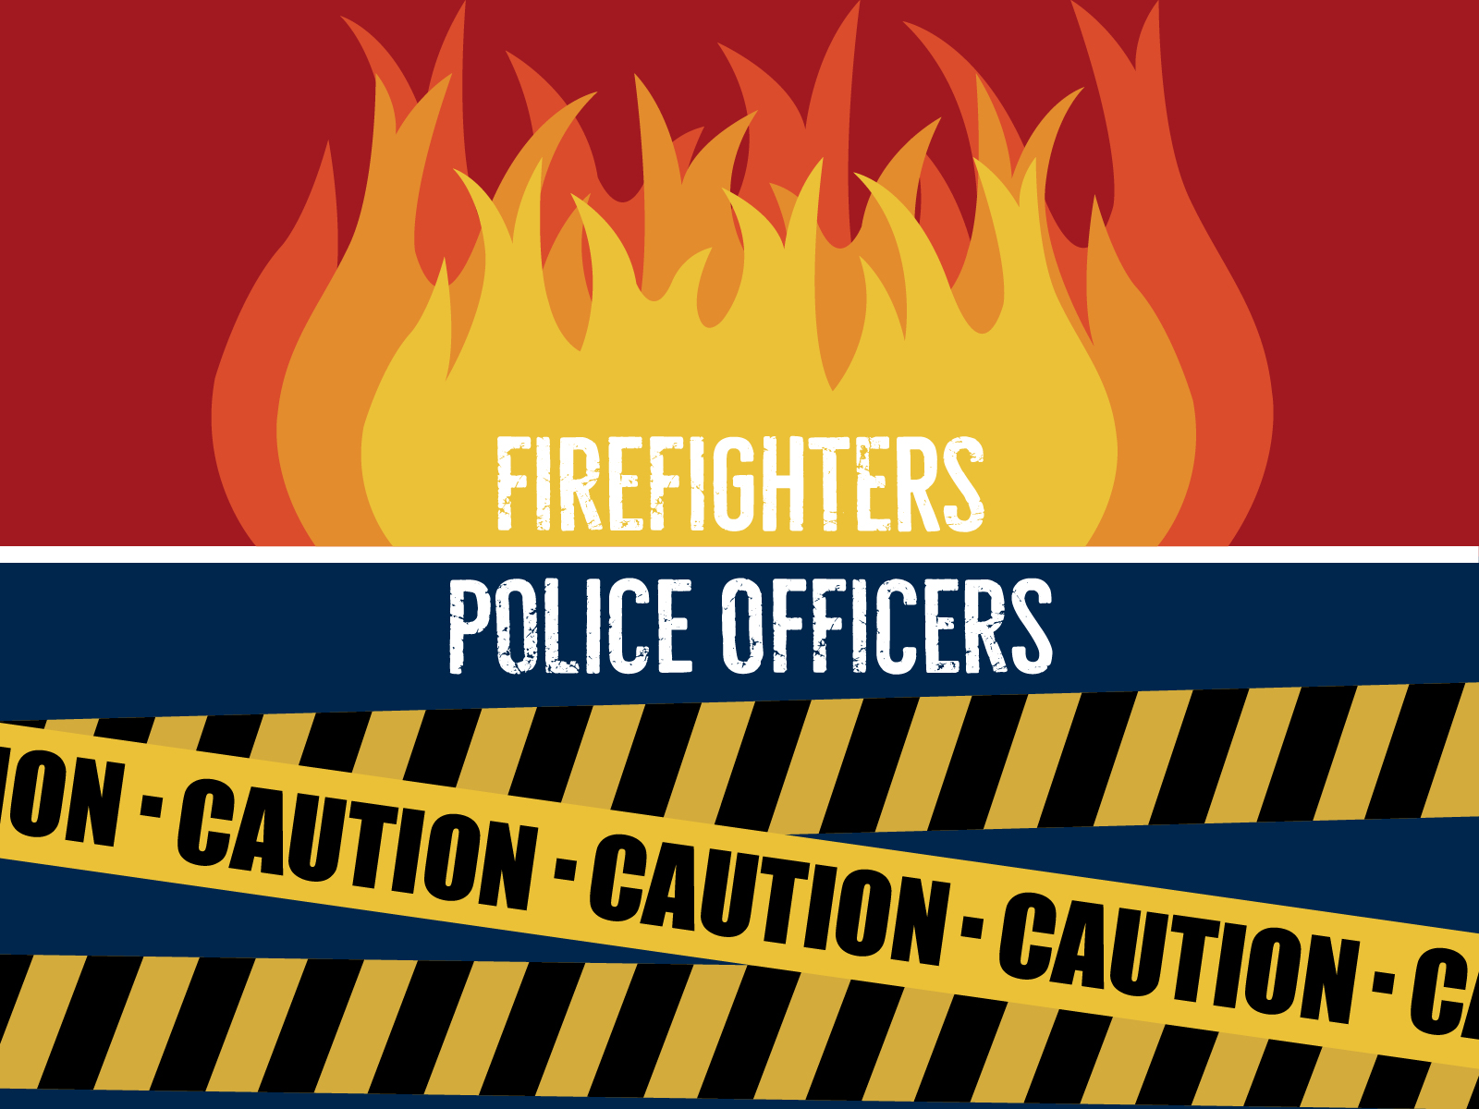
How Do You Quantify Best?
Fill Me In
Living Assistance based upon help needed to be provided by the city of Pittsburgh for these neighborhoods in regard to fires police incident reports, and crime arrests.
Notes:
-How do you quantify best?
-What made you settle on this definition?

Slide 3

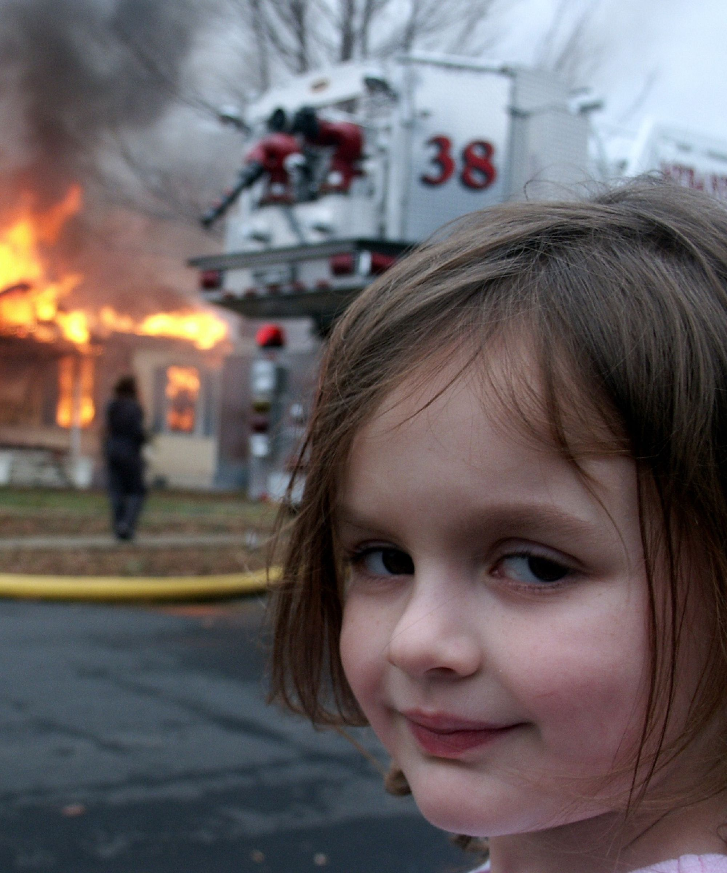
Where's the Data?
FIRE
Notes:
-Which dataset did you use?
-Why did you pick these specific datasets?
-Explain the details about these datasets(how many datapoints, when was it started, is it a current dataset, who collected )
FIRE DATA

Slide 4
Things to Note
1.Fires Incidents are worth 5pts each
2.Police Arrests for Crimes were multiplied by 0.5
3. No weight was added to Police Incident Reports (Added after this presentation)

Slide 5
Link to Code
https://github.com/joyousjay/CMPINF-0010-Final-Project/blob/master/Panther%20Central%20Project.ipynb
(link does not work as we updated the notebook)

Slide 6
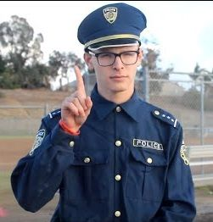
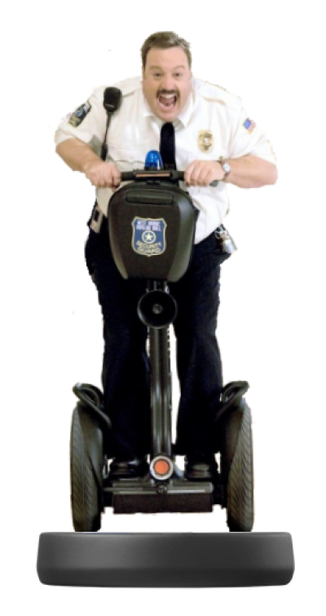
Arrest Data
Neighborhoods with Most Arrests
Shadyside
Squirrel Hill South(of Forbes)
North Oakland
Squirrel Hill North
Central Northside
Middle Hill
East Liberty
Lower Oakland
Mount Washington
Homewood South
Statistics
Max Arrests: 1226
Min Arrests:18
Avg Arrests: 622
Worst Arrests: Shadyside
Best Arrests: East Carnegie
Neighborhoods with Least Arrests​
East Carnegie
Harpen Hilltop
Swisshelm Park
Bon Air
Esplen
West End Valley
Regent Square
California Ave.
Morningside
Elliot

Slide 7

Fire Incident Data
Neighborhoods with Most Fire Incidents
Carrick
Central Business District
Southside Flats
Hazelwood
Squirrel Hill South(of Forbes)
East Liberty
Homewood North
Lincoln-Lemington-Belmar
Mouth Washington
Sheraden
Statistics
Max Fires: 220
Min Fires: 4
Avg Fires: 112
Worst Fires: Carrick
Best Fires: Mount Oliver Borough
Neighborhoods with Least Fire Incidents
Mount Oliver Borough
Regent Square
East Carnegie
Mount Oliver
Arlington Heights
Oakwood
Hays
Chartiers City
Swisshelm Park
St. Clair

Slide 8
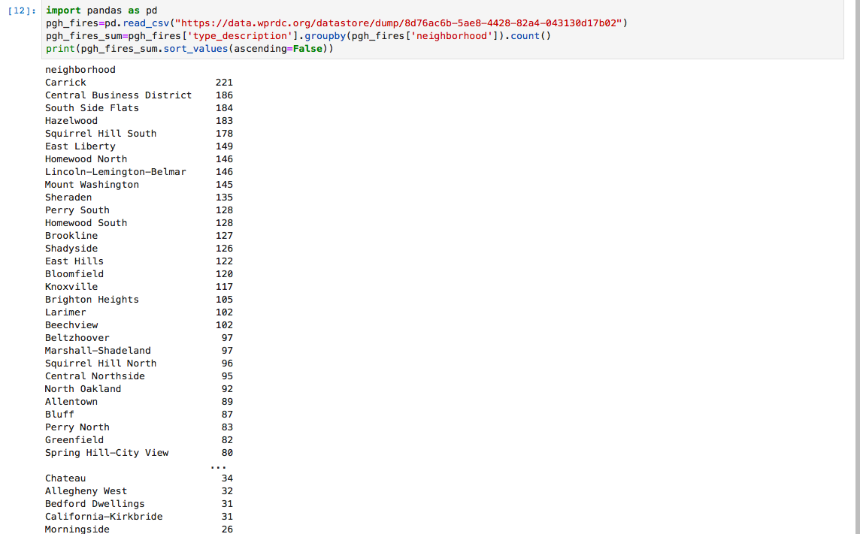

Slide 9
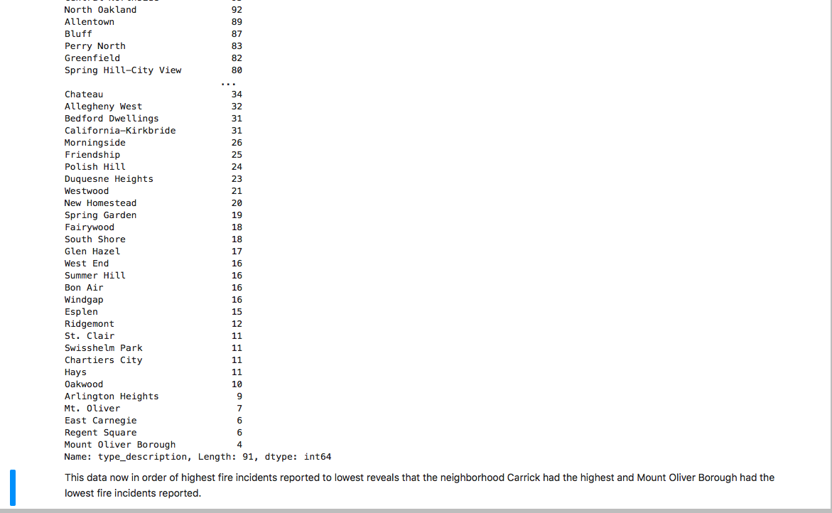

Slide 10

Best Neighborhood in Pittsburgh?

Slide 11

East Carnegie
Fire Statistics
Arrest Statistics
Number of Fires: 6
Number of Arrests: 18
Number of Points:48 points

Slide 12
Worst Neighborhood in Pittsburgh?

Slide 13

Squirrel Hill South
Fire Statistics
Arrest Statistics
Number of Fires:126
Number of Arrests:1066
Number of Points: 1698

Slide 14

Is There Any Correlation or Causation?

Slide 15
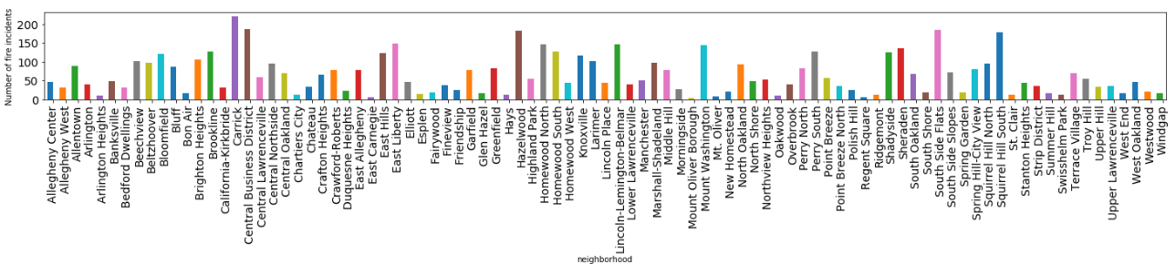
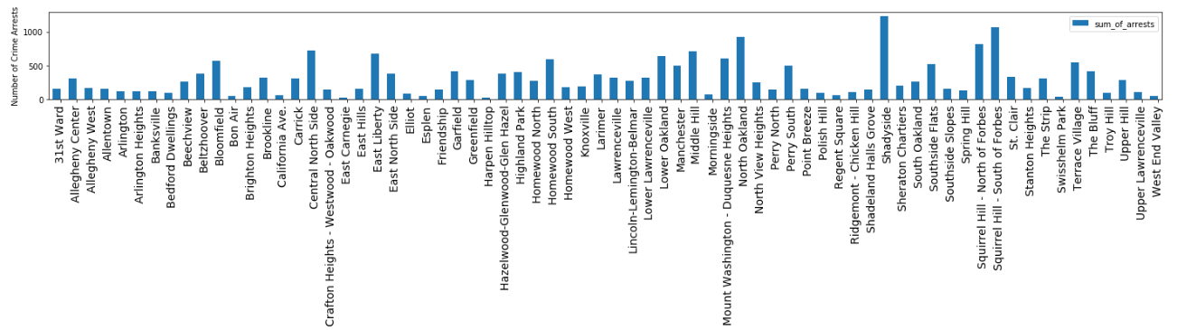
FIRES
ARRESTS

Slide 16
Correlation
Highest Arrests
Highest Fires
Shadyside
Squirrel Hill South(of Forbes)
North Oakland
Squirrel Hill North
Central Northside
Middle Hill
East Liberty
Lower Oakland
Mount Washington
Homewood South
Carrick
Central Business District
Southside Flats
Hazelwood
Squirrel Hill South(of Forbes)
East Liberty
Homewood North
Lincoln-Lemington-Belmar
Mouth Washington
Sheraden

Slide 17
Correlation
Lowest Arrests
Lowest Fires
East Carnegie
Harpen Hilltop
Swisshelm Park
Bon Air
Esplen
West End Valley
Regent Square
California Ave.
Morningside
Elliot
Mount Oliver Borough
Regent Square
East Carnegie
Mount Oliver
Arlington Heights
Oakwood
Hays
Chartiers City
Swisshelm Park
St. Clair

Slide 18

Thank You

